Slide 1
Tau Beta Pi Initiate Pizza Party & Information Session
Thursday, September 20, 2018

Slide 2
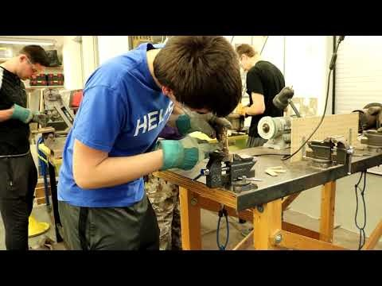

Slide 3
Why TBP?
Purpose:
To recognize students in engineer that have shown distinguished scholarship and exemplary character
Community:
247 chapters across the US with over 594,000 members
Fun Facts:
Only honor society representing all engineering disciplines
2nd oldest honor society in the U.S.
Top 1/8 of Junior Class, 1/5 of Senior Class

Slide 4
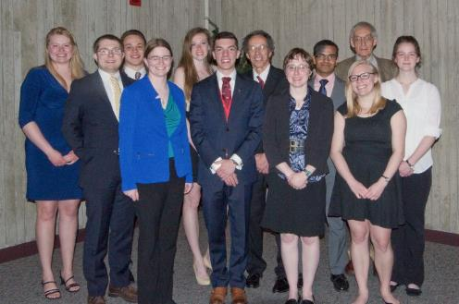
Tau Beta Pi at Iowa State
One of the most active and awarded chapters in the country
6+ service projects per year
Career-oriented events
Eighteen buildings on campus are named for TBP members.
Every Dean of Engineering has been a TBP member, including the present Dean, Dr. Sarah Rajala

Slide 5
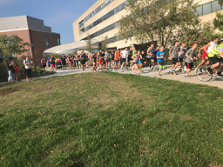
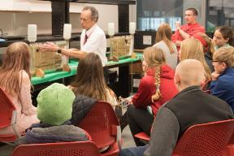
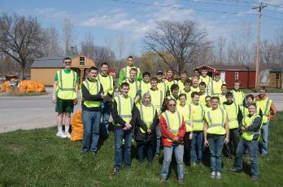
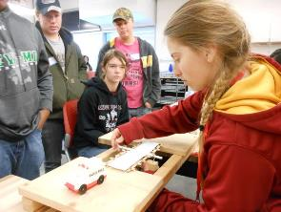
Service Projects
Spring 2018
Roller Coaster Competition
Tau Beta Pi(e) Day
Adopt-A-Highway
Fall 2018
Pi Mile Run
Building the Future
Adopt-A-Highway
.

Slide 6
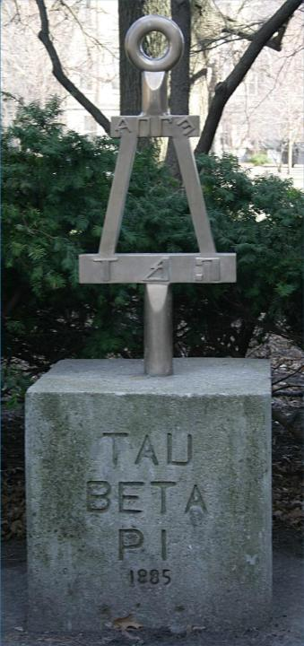
How To Get Involved
Cabinet
Elections at end of each semester
General Meetings
Every other week – often with guest speakers
Committee Meetings
Chapter projects, Initiation, Chapter Improvement
Service Projects
Small Group Leadership
Professional Skills Workshops

Slide 7
Initiation Process Overview
Completing the activities demonstrates:
Character
Commitment to Service
Leadership
Dedication
Payment of fee is only part of membership; active participation in initiation activities is essential

Slide 8
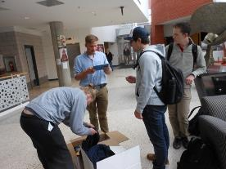
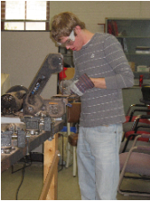
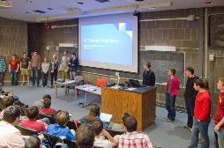
Initiation Process Components
Participate in at least:
Three Small Group Meetings
One Engineering Futures Session
Service Projects (2 hours)
One General Meeting/Presentation
One Committee Meeting
Bent Polishing
Quiz
Initiation Ceremony
13-15 hours overall...

Slide 9
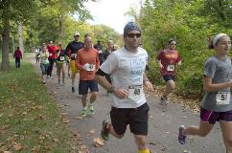
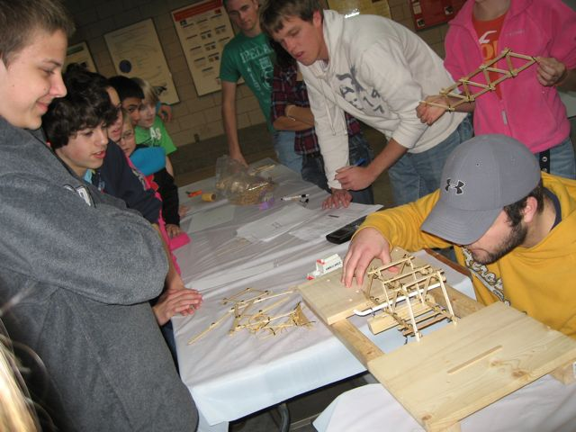
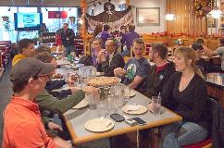
Initiate Small Groups
Fall Semester Small Groups include planning for:
Audio/Visual TBP Academy (Mon. 6:10-7pm)
Company Visits/Tours (TBA)
MindSET K-12 Outreach (Tues. 2:10-3pm)
Planning a Scholars Event (Wed. 7:10-8pm)
Planning a Social Event (Wed. 4:10-5pm)
Service Project Development (Tues. 5:10-6pm)
Tau Beta Pi Marketing (Mon. 7:10-8pm)
Website Redesign (Mon. 7:10-8)

Slide 10
Initiation Process Explanations
Engineering Futures Session
Bent Polishing
Quiz

Slide 11
Where does my initiation fee go?
One time $90.00 fee makes you a life member of Tau Beta Pi!
$55.00 of fee goes to National Headquarters, includes:
Membership Certificate, Key and Card
4-year subscription to The Bent
National Convention Assessment
Expenses of the Tau Beta Pi Association
$35.00 of fee stays with Iowa Alpha to support:
Initiation Supplies and Materials
Cost of Initiation Ceremony & Banquet
Food for Engineering Futures participants
Food for Information session and FAC
Funding of Chapter Outreach activities

Slide 12
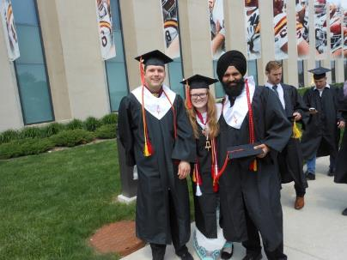
Benefits of Membership
Tau Beta Pi Graduate Fellowships ($10,000) and Undergraduate Scholarships ($2000) available
5 scholarship awarded to IA A members in 2018
Tau Beta Pi Job Board
Leadership opportunities
Cabinet Positions
Small Group Leaders
FE and PE test preparation materials
Graduation Stoles

Slide 13
Benefits of Membership
Networking:
Jobs
Graduate Schools
Academic Positions
Guest Speakers
Exclusive company presentations

Slide 14
Next Steps
Small Group signup on Canvas
Week of September 24 – 28
Attend at least 3 small group meetings
Weeks of October 1-5 through October 22-26
Attend Engineering Futures Session
Saturday, October 20 (morning or afternoon), or
Sunday October 21 (morning)
Attend Bent Polishing
Sunday, October 7 or Sunday, October 28
Perform Service Activity (2 hours)
Free Coffee Friday – every other Friday
Adopt a Highway Cleanup – Sunday, October 21
Building the Future – Thursday, November 15
Participate in General Meeting - Small Group Presentation
Tuesday, October 30
Attend a Committee Meeting – Officer Election
Tuesday, November 6
Attend Tau Beta Pi Initiation Ceremony and Dinner
Sunday, December 2 **Mandatory for Membership**

Slide 15
Connect with us!
eBent Weekly News
Canvas
A list of events is also posted on the Iowa Alpha website at: http://iowaalpha.tbp.org/

Slide 16
Questions? Feel free to contact:
Brett Niemann, Initiation Officer – bniemann@iastate.edu
Daniel Rolfes, Graduate Initiation Officer – djrolfes@iastate.edu
Branden Moreau, Iowa Alpha President – morebr01@iastate.edu
LeVern Faidley, Chief Advisor – levern@faidley.org
80 New Members - Spring 2018
(76 undergraduates, 2 graduate students, 2 Eminent Engineers)

